Slide 1
Randomized Algorithm : Finger Printing
Computation Complexity
Presented by :-
Geetanshu Dev Mesharm
5th semester
300012821043
Data Science

Slide 2
Index
Deterministic Algorithm
Randomized Algorithm
Why we use Randomized Algorithm
Deterministic vs Randomized Algorithm
Types of Randomized Algorithm
Advantages & Disadvantages Algorithm
Application
Fingerprinting
Fingerprinting Algorithm
Use cause of Fingerprinting
Fingerprinting in Randomized algorithms

Slide 3
Deterministic Algorithm
In deterministic algorithm , given a particular input , computer always produce same output going through same state .
It can solve at polynomial time .
It can determine next output.
Solution produce by algorithm is correct.
Deterministic Algorithm structure
Algorithm
Input
Output

Slide 4
But the Problem is
It may difficult to formulate an algorithm with good running time or
The exploitation of running time of an algorithm for that problem with number of inputs.

Slide 5
Randomized Algorithm
Define = A randomized algorithm is an algorithm that employes degree of randomness as a parts of its logic.
OR
An algorithm that uses random number to decide what to do next anywhere in its logic is called Randomized algorithm.
Algorithm
Input
Output
Randomized Algorithm Structure
Random Input

Slide 6
Why We use Randomized Algorithm ?
To overcome computational problem of the exploitation of running time of an deterministic algorithm.
It uses uniform random bits also called pseudo random number as an input to guide its behaviors.
Avoid Worst-Case behaviors : randomness can guarantees average case behaviors.
To improve efficiency with faster run time.
In Distributed computing , each machine only has a part of data , but still have to take decision that affects the global outcomes. Randomized algorithm is key role in informing this decision.

Slide 7
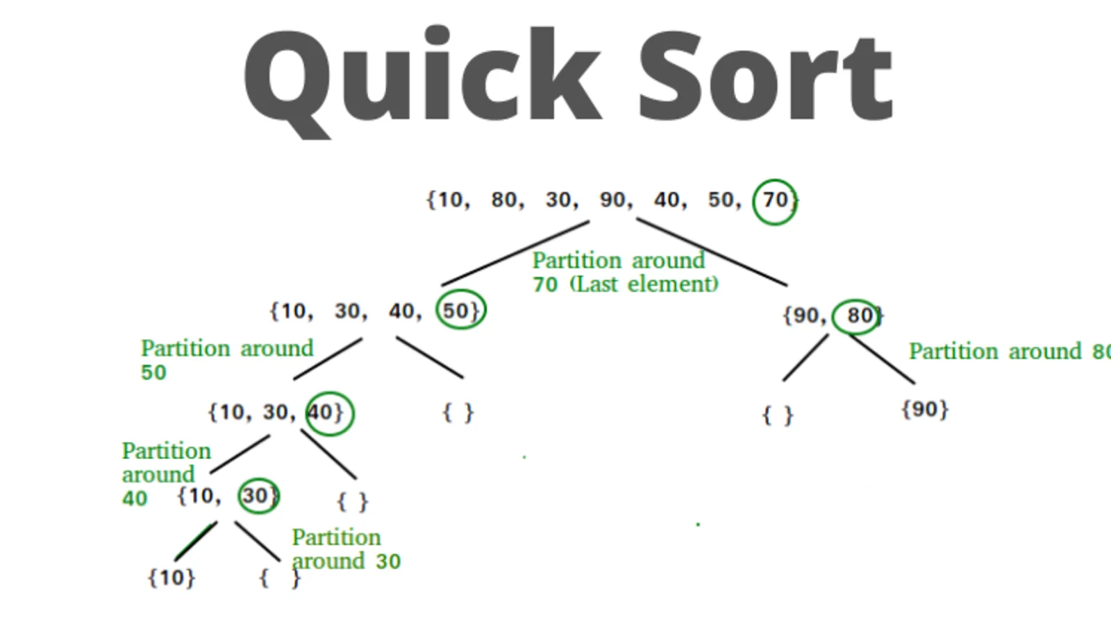
Lets take example of Quick Sort

Slide 8
Deterministic vs Randomized Quicksort
Deterministic Quicksort : The pivot is chosen deterministically, for example, always the first unsorted element, or the element halfway through. This means that for a particular input, the pivot selection is predictable and can lead to worst-case behavior (O(n^2) time complexity) if the pivot chosen is consistently either the minimum or the maximum.
Randomized Quicksort : The pivot is chosen randomly from the array at each step. This means that while you technically could choose the same pivots as in the deterministic case, it's very unlikely that this will happen and trigger the worst-case behavior. The random selection of the pivot leads to a better expected performance over all datasets.

Slide 9
Types of Randomized Algorithm
There are two types of Randomized algorithm :-
Randomized
Algorithm
Las Vegas
Algorithm
Monte Carlo
Algorithm

Slide 10

Las Vegas Algorithm
It always produces correct output.
Its running time is random
Running time is based on random value time complexity is evaluated as expected value.
Expected running time should be polynomial.
Uses in Improve performance.
Simple e.g. is quicksort where pivot point choses as randomly.

Slide 11

Monte Carlo Algorithm
It may produce Incorrect answer with certain probability.
We are able to bound its probability.
Monte Carlo mainly used in three classes optimization, numerical integration and generating draw from probability distribution.
Used in variety of field including Physics , business risk calculation , system engineering problem , and many more
It named after Monte Carlo Casino in Monaco.

Slide 12
Advantages of Randomized Algorithm
Randomized algorithm are often simpler and faster than their deterministic counterpart.
The algorithm is very fast with high probability.
Produces optimum output .

Slide 13
Disadvantages of Randomized algorithm
Analysis of running time or probability of getting correct answer usually difficult.
Getting truly random number is impossible , one needs to be depend on pseudo random numbers. So , result highly depend on quality of random numbers .

Slide 14
Application
Randomized Quick Sort .
On cryptography like RSA –Crypto system.
Data Structures : Hashing, sorting, searching, computational geometry.

Slide 15
Finger Printing
Human fingerprints are defined by tiny ridges, spirals and valley patterns on the tip of each finger. They are unique: no two people have the same ones.
A fingerprinting algorithm in computer science is one that maps large data (such as documents or images) to a much shorter sequence of bytes. Such a sequence may be called the data's fingerprint. In essence, large data is more tersely represented by its fingerprint. This fingerprint uniquely identifies the original data, just as human fingerprints uniquely identify individual people.
Fingerprinting can be applied to different types of inputs: documents, images, audio, video, or any arbitrary data.

Slide 16
Fingerprinting Algorithm
Process of converting a large data object into smaller , fixed size representation that uniquely identifies the original object.
Properties of good fingerprinting algorithms :-
Collision resistance : two different input should have a very low probability of generating same fingerprinting.
Avalanche effect : Small changes in input should cause large changes in the fingerprint.
Efficiency: algorithm should be fast and use minimal resources.

Slide 17
Use Causes Finger printing
When we need to search large filesystems or databases, fingerprints are used to speed up data retrieval. Rather than compare large amounts of content, it's sufficient to compare their fingerprints.
When we upload files, cloud providers use fingerprints to do deduplication so that multiple copies of the same file are avoided. When users upload content to public sites, fingerprints can tell if it's banned or copyrighted content.
In companies, fingerprints can prevent employees from emailing sensitive content such as patent documents.
For identification, audio fingerprinting is used to identify songs.

Slide 18
Different Fingerprinting Algorithms
Hash functions, also called fingerprinting functions, are often used to reduce arbitrary length of data to a fixed length of bytes. The output is called a hash or a fingerprint.
ML algorithms for fingerprinting are trained on deterministic data and then used for prediction. However, these require lots of training data.

Slide 19
Fingerprinting in Randomized algorithm
Fingerprinting in the context of randomized algorithms is a technique to easily compare two objects by comparing there hashes.
Randomization can be used to design efficient fingerprinting algorithms with strong collision resistance.
Randomized algorithm can be used to improve performance of fingerprinting algorithms , such as by reducing number of comparisons required.

Slide 20
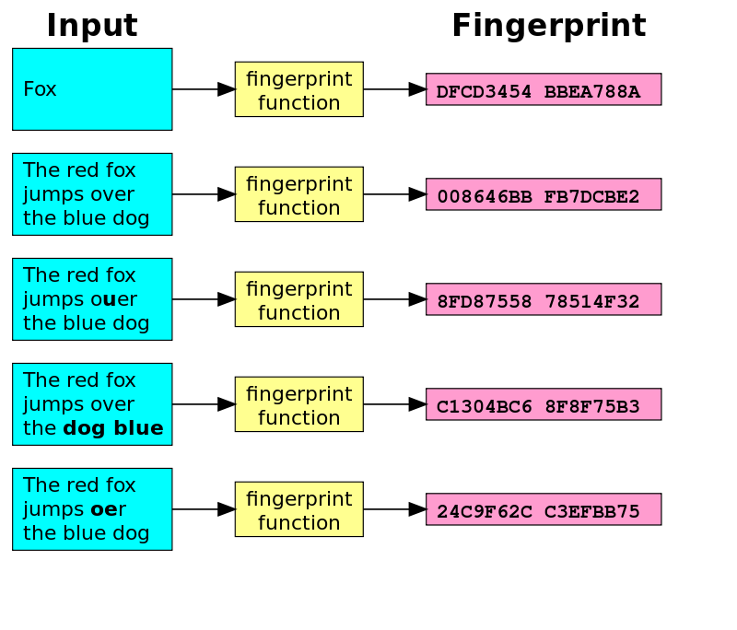
Illustration of Fingerprinting function

Slide 21


Application or Product that use Fingerprinting
Since 2007, YouTube's been using a system called Content ID to flag content that infringe copyrights. It uses both audio and visual fingerprinting, and more recently enhanced with machine learning.
Shazam identifies songs based on audio fingerprinting. Audible Magic employs its audio/video fingerprinting technology for content providers who wish to protect their copyrighted content.

Slide 22
Thank You

